Slide 1


M.Tech Program
Advanced Industry Integrated Programs
Jointly offered by University and LTIMindTree
Project Title
AI Voyage Planner: Context-Aware Travel Recommendations and Adaptive Scheduling
Team Member
S Syed ali Fathima
Crescent 2025-27
Knowledge partner | Implementation partner

Slide 2
Project Title - Calibri body 18
Introduction
Travel planning is often fragmented, requiring users to search multiple websites for destinations, hotels, transportation, and travel schedules.
Most travel recommendation systems provide generic or popularity-based suggestions rather than personalized recommendations.
Existing tourism platforms rarely consider a traveler's budget, available time, interests, and travel preferences simultaneously.
Travel plans are typically static and require manual modifications when weather conditions, transportation schedules, or attraction availability change.
AI Voyage Planner is proposed as a Generative AI and RAG-based intelligent travel assistant that provides personalized recommendations and dynamically adapts itineraries to changing travel conditions.

Slide 3
Project Title - Calibri body 18
Objective
To develop an AI-powered travel planning assistant for personalized tourism recommendations.
To understand user preferences including budget, travel duration, destination, and interests.
To retrieve relevant travel information using Retrieval-Augmented Generation (RAG). generate intelligent and personalized travel itineraries using Large Language Models.
To dynamically update travel schedules based on weather changes, transportation delays, and attraction availability.
To provide an interactive dashboard for seamless travel planning and management.

Slide 4
Project Title - Calibri body 18
Scope
Provide personalized travel recommendations based on user interests, budget, and destination.
Generate optimized day-wise itineraries with efficient route and time planning.
Retrieve relevant tourism information using RAG from a travel knowledge base.
Dynamically adapt travel schedules based on weather updates, attraction closures, and travel disruptions.
Support travelers with intelligent recommendations and decision-making for an enhanced travel experience.

Slide 5
Project Title - Calibri body 18
Literature Review
S.NO | PAPER TITLE | AUTHOR | YEAR | CONFERENCE/JOURNAL | REFERENCE
1. | A Survey of Large Language Models | Wayne Xin Zhao, Kun Zhou, Junyi Li et al. | 2023 | arXiv / Springer Survey | Reviews LLM capabilities in natural language understanding and content generation, supporting AI-generated travel itineraries and recommendations.
2. | Recommender Systems in Tourism | Francesco Ricci | 2020 | Handbook of e-Tourism (Springer) | Discusses tourism recommendation techniques, itinerary generation, and context-aware travel planning relevant to intelligent tourism systems.

Slide 6
Project Title - Calibri body 18
Summary of Literature
Traditional travel systems mainly rely on predefined recommendations and popularity rankings.
Recommendation systems improve personalization but often lack real-time adaptability.
RAG improves response accuracy by grounding LLM outputs with retrieved information.
Generative AI enables natural-language itinerary generation.
Context-aware systems significantly enhance user satisfaction by considering preferences and environmental factors.

Slide 7
Project Title - Calibri body 18
Additional Information
RAG architecture provides accurate travel recommendations using real tourism data.
ChromaDB enables efficient retrieval of tourism information.
LangChain orchestrates retrieval and generation workflows.
Llama 3 running through Ollama provides local AI inference capabilities.
Adaptive scheduling enables automatic itinerary updates in response to disruptions.

Slide 8
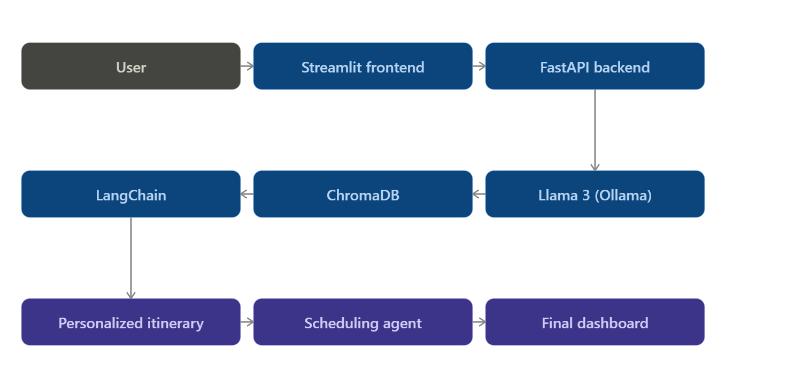
FLOWCHART

Slide 9
Project Title - Calibri body 18
Modules to cover: core intelligence
Data Ingestion & Processing: Collect attraction, hotel, and transportation datasets.Clean and structure tourism information.
Embedding Generation: Convert tourism data into semantic embeddings.Store embeddings in ChromaDB.
Vector Retrieval: Retrieve the most relevant travel information based on user queries.
RAG-Based Recommendation Engine: Combine retrieval results with user preferences.Generate context-aware recommendations.
Natural Language Interaction: Allow users to interact through a conversational interface.

Slide 10
Project Title - Calibri body 18
Tourism Intelligence
Personalized Travel Recommendation: Recommend attractions aligned with user interests.
Itinerary Generator: Create optimized day-wise travel schedules.
Budget Planner: Recommend suitable activities within budget limits.
Dynamic Scheduling Agent:Monitor travel conditions.Update travel plans automatically.
Decision Support SystemOffer alternative attractions and travel options.
Improve travel efficiency and convenience.

